Slide 1


Introduction to Machine Learning Part 7: Deep Learning case studies
Jaume Bacardit
Interdisciplinary Computing and Complex BioSystems (ICOS) research group, School of Computing, Newcastle University
Jaume.Bacardit@Newcastle.ac.uk
Twitter: @jaumebp

Slide 2
Outline
Two case studies of deep learning applied to different areas, from some of the work of my team
Precision farming
Characterisation of human social interaction from wearables

Slide 3
Precision farming
Resilient, cheap but safe food production is crucial due to the demands of the growing world population
Precision farming refers in a broad sense to the use of technologies, ideally automated, to assist the functioning of a farm in order to maintain a sustained level of productivity
But also to ensure the well-being of farm animals
The first step in precision farming is the use of appropriate monitoring technologies to provide useful information to the farmers

Slide 5
Early warning system from environmental sensors for farm animals
This application combines two biologically-inspired computing paradigms: Particle Swarm Optimisation and Deep Learning
Idea: sensors that continuously capture environmental data (temperature, humidity, CO2) in pig farms
Can the changes in these environmental readings provide us with an early alert of a disease outbreak?

Slide 6
The data
Three farms from three different EU countries were monitored
Each farm was represented by a number of batches of pigs (3-16 batches – 40 – 1294 pigs) spanning varying lengths of time (14-145 days)
The number of pigs/batch affected by respiratory diseases was recorded daily, as measured by experts
Environmental data (Temperature, CO₂, Humidity) was recorded every minute
Any day in which at least one pig was ill was considered an “unhealthy” day
This was used to segment the data of each batch into “healthy” and “unhealthy” time periods

Slide 7
Early warning system from environmental sensors for farm animals
Environmental sensors
Sensors data for a window of time
Role of Deep Learning
Combination of two DL concepts
GRU: Gated Recurrent Units
NN node designed to process time series data
Simplified version of LSTMs
Autoencoder
Learns to reconstruct the input data it sees
In this case, 30’ time series of sensor data
It is trained with “healthy” data intervals from our batches
Once it sees anomalous data, we expect the reconstruction error to be larger than for the normal data
We use a validation set of “healthy” data to construct a distribution of normal reconstruction errors
And then the Mahalanobis distance to construct an anomaly estimate
Quantifies how different is the current window of sensor data from the “normal” data used to train the algorithm
Deep Learning: GRU Autoencoder
Takes the normality estimate 𝛕 and makes specific predictions of disease outbreak 𝝰 days into the future that lasts for β days
PSO-optimised anomaly detector

Slide 8
GRU vs LSTM
https://feature.engineering/difference-between-lstm-and-gru-for-rnns/

Slide 9
Early warning system from environmental sensors for farm animals
Sensors data for a window of time
Role of PSO
To optimise the generation of alerts
Find the values for the 𝛕 threshold, 𝝰 and β (the particle) that
Make good predictions (measured using the Matthews Correlation Coefficient
Early prediction (large 𝝰)
The prediction is valid for a small time interval (small β)
Fitness = 2 x MCC + 𝝰 - β
Environmental sensors
Quantifies how different is the current window of sensor data from the “normal” data used to train the algorithm
Deep Learning: GRU Autoencoder
Takes the normality estimate 𝛕 and makes specific predictions of disease outbreak 𝝰 days into the future that lasts for β days
PSO-optimised anomaly detector

Slide 10
Early warning system from environmental sensors for farm animals

Slide 11
Early warning system from environmental sensors for farm animals

Slide 13
Overview
Input data: Video cameras (e.g. CCTV) continuously monitoring the pen where the animals are
Transition away from pen-level treatment to individual-level
Developed a system to localise & track individual pigs
Without marking or tagging the pigs
Extract behavioural metrics from individual pig tracks
Use for individual-level assessment & treatment

Slide 14
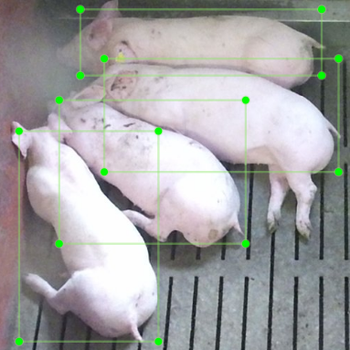
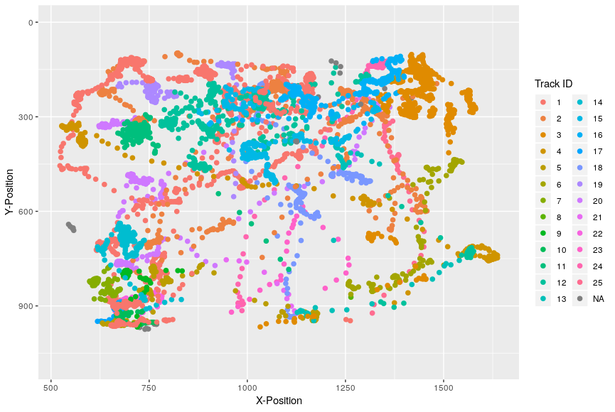
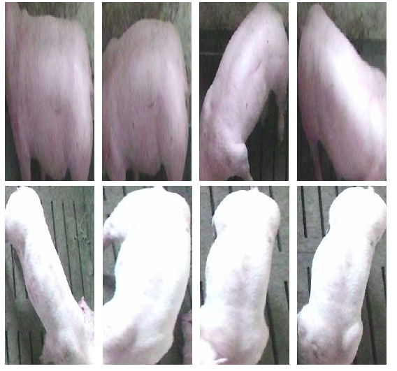
Datasets
Pig Detection
Pig Tracking
Pig Re-ID
Bounding boxes of pigs in images
Location of individual pigs across a video
Sets of images of the same pig
1,646 images
9,014 annotations
25 pig tracks
7.8 minute video @ 4 FPS
1,874 frames
25 pig identities
5,653 total images
Resized to 128 x 256
Notes:
We also used ImageNet & Pascal VOC 2007 in detection and MARS in re-identification

Slide 15
Implementation
Faster R-CNN
Deep SORT
Behavioural Metric Extraction
An object detection method for localising and classifying objects within in an image Uses the Pig Detection dataset
Uses the trajectory and visual appearance of detected objects to track each of them between frames Uses the Pig Tracking & Re-ID datasets
Using the tracks from Deep SORT we extracted metrics about each pig’s activity: distance travelled, average speed, time spent idle Uses metrics extracted from the Pig Tracking dataset
Faster R-CNN: Towards Real-Time Object Detection with Region Proposal Networks - https://arxiv.org/abs/1506.01497

Slide 16
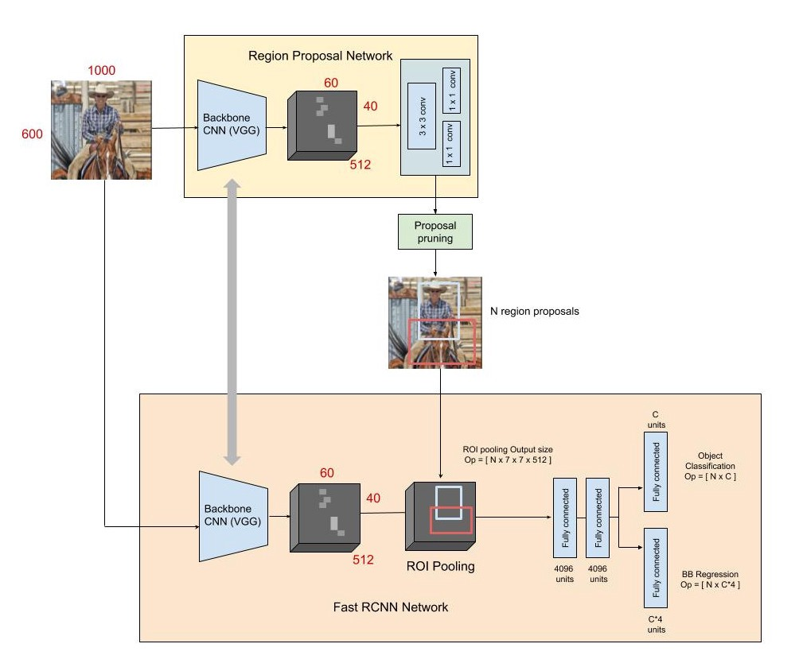
Faster R-CNN
The output of these network is
A series of rectangles for the detected objects
A predicted class for each object
The network is split in two parts
The region proposal network, focusing only in placing bounding boxes around “potentially interesting” objects
The network that predicts the actual identity of the objects by focusing on the parts of the image that concentrate most RoI.
https://towardsdatascience.com/fast-r-cnn-for-object-detection-a-technical-summary-a0ff94faa022

Slide 17
Full Workflow
Label Training Data
Faster R-CNN
Deep SORT
Apply to Test Dataset
Extract Behaviours from tracks
• Draw regions of interest around each pig • Assign an ID to each pig
• Faster R-CNN pretrained on ImageNet, then trained on Pascal VOC 2007 datasets
• Faster R-CNN trained on pig detection dataset using transfer learning
• Deep SORT trained to re-identify humans using visual appearance (MARS dataset)
• Deep SORT trained to re-identify pigs based on visual appearance using Pig Re-ID dataset
• Faster R-CNN & Deep SORT are applied to the Pig Tracking dataset
• Individual behaviour metrics are extracted from the tracks
• These are evaluated against the ground truth tracks

Slide 18
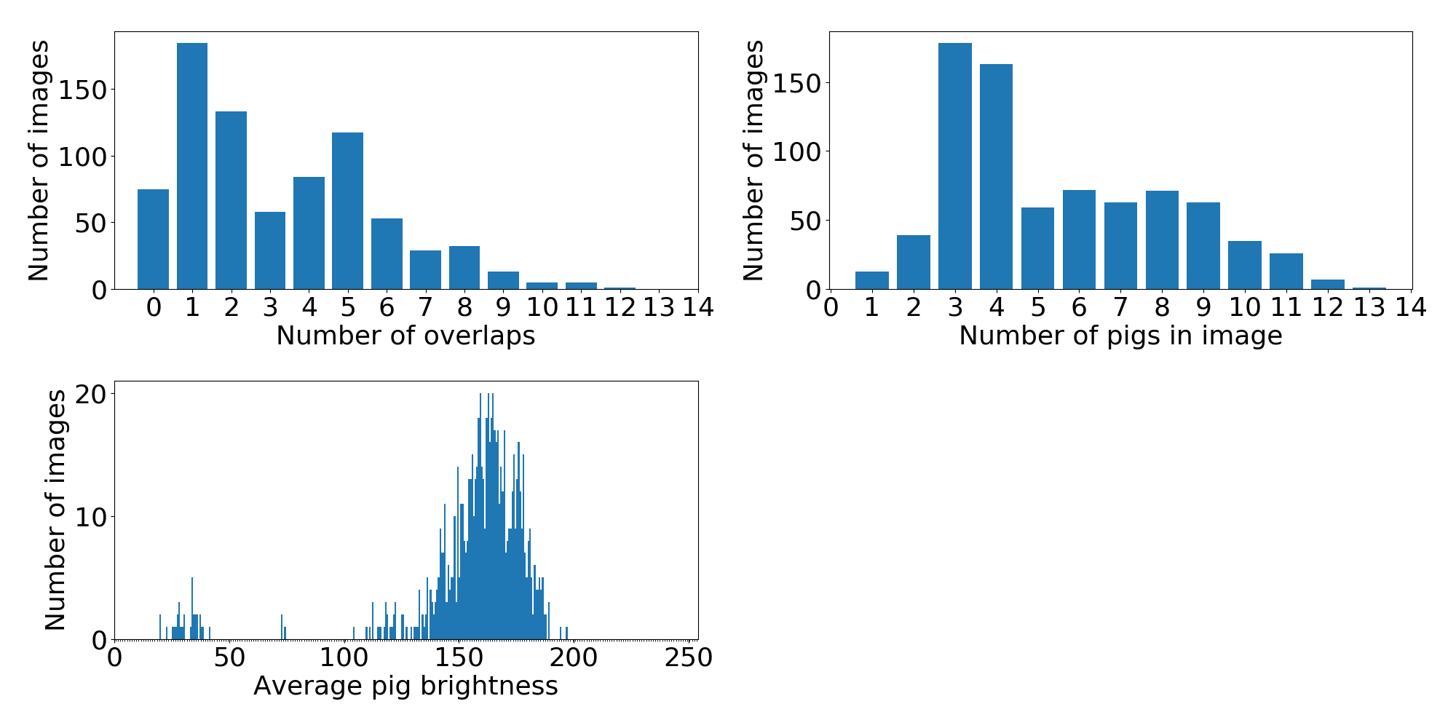
Results - Detection
Overall
0.901 mAP Many pigs >10 pigs in image
0.905 mAP
Densely packed 4 or more overlapping pigs
0.906 mAP
Overexposed Bright sunlight distorts the image
(manually selected)
0.906 mAP
Low-light Average pig brightness < 100
0.850 mAP
Notes:
The detection test set was broken down into 4 subsections in order to better evaluate the performance under different conditions Many pigs = more than 10 pigs in the image (4% of test set)
Densely packed pigs = 4 or more overlapping bounding boxes (43% of test set)
Overexposed images = where sunlight distorts the image [manually selected] (11% of test set)
Low-light = Average pig brightness in an image

Slide 19
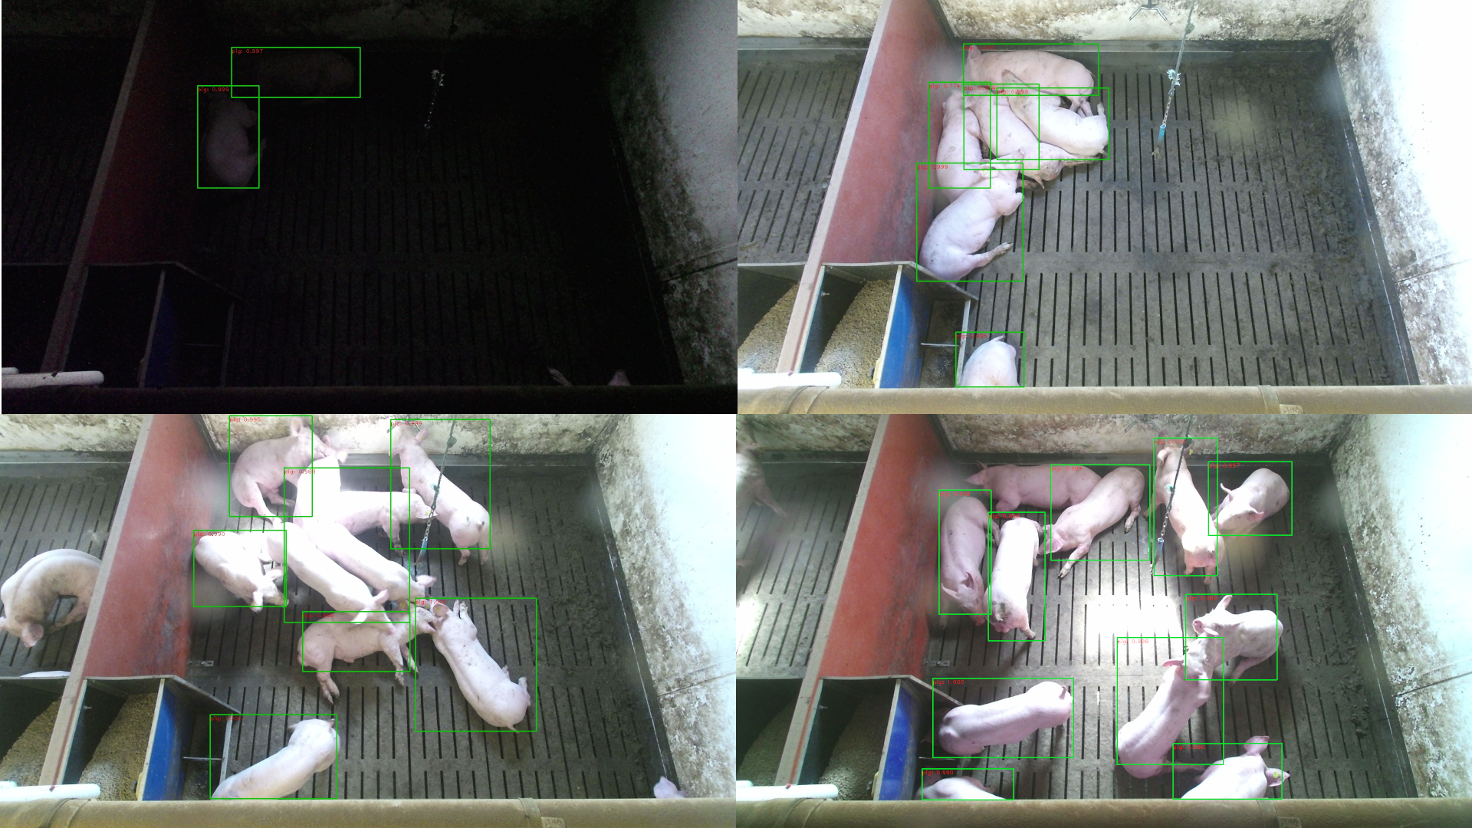
Results - Detection
Notes:
Top-bottom, left-right:
Low-light
Densely packed
Overexposed
Many pigs

Slide 20

Results - Tracking
MOTA 0.95
How well we track multiple pigs
IDF1 0.73
How well we retain IDs of individual pigs

Slide 21
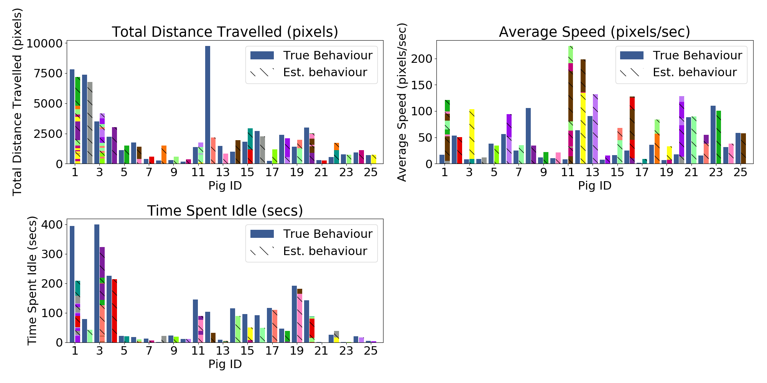
Results - Behaviour Extraction
Total Distance Travelled 0.015 MSE
Time Spent Idle 0.008 MSE
Average Speed 0.008 MSE

Slide 23
Aims & Objectives
Monitoring and assessing the different aspects of Social interaction in naturalistic setting environments using a wearable device.
There is a close connection between behaviour and wider social interactions
To capture “naturalistic” settings technology has to be unobtrusive

Slide 24
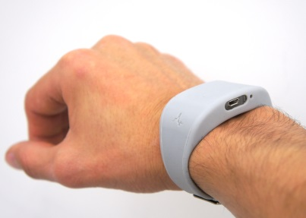
Study device
WAM (Wearable Acustic Monitor) is a stand-alone, wrist-mounted device…
Microphone (8KHz)
Tri-axial Accelerometer (50Hz)
Internal storage
Lithium ion battery
duration of seven days of continuous unobtrusive data capture
https://github.com/digitalinteraction/openmovement
Notes:
WM … that recorded physical activity via three accelerometers and audio via a microphone.
It has no buttons or UI so, There is no fear that the user could accidentally press a button and the device stop recording or losing valuable data,
the device is ready as soon as it is put on.

Slide 25
Speech Detection in Naturalistic Environments
Also called voice activity detection (VAD)
VAD: Determine whether speech is present in a particular audio signal
Issues: loud noise classified as speech and soft speech classified as noise

Slide 26
NatSpeech: Network Architecture

Slide 27
Bi-Directional Recurrent Neural Networks
A variant of RNNs in which the time series is passed twice through each layer
A forward pass (start → end)
A backwards pass (end → start)
The output of the bidirectional layer combines information extracted from both passes

Slide 28
Datasets
Public Datasets:
Aurora 2(annotated)
Aurora 4(annotated)
TIMIT(annotated)
Depression Dataset (sensitive data): 7 days per participant, unannotated
30 healthy control subjects
30 depressed patients
Because of privacy reasons, this audio dataset can only be automatically processed to extract features, but no human can listen to it
Discussion Dataset: (will be used for training and validation)
15 sessions of non-sensitive discussions (annotated) spanning 12h of recordings

Slide 29
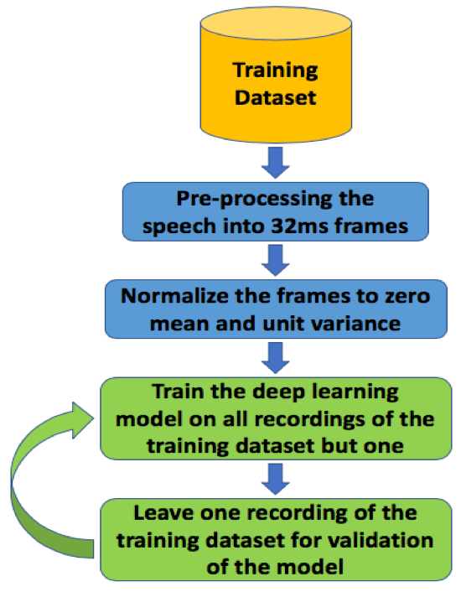
Validation Process for datasets in which annotations is available Leave-One-Session-Out Cross Validation

Slide 30
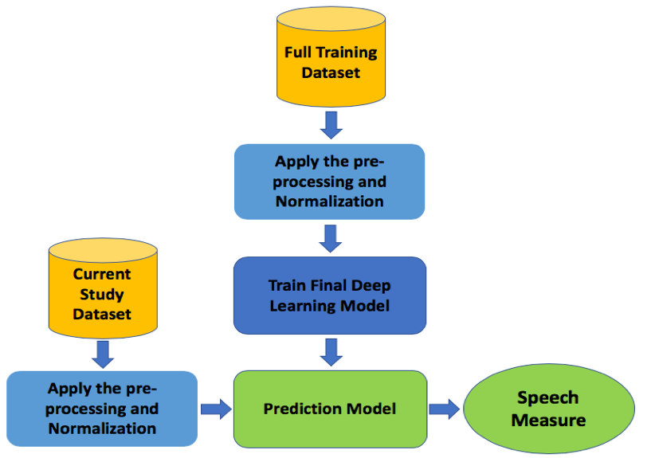
Application of our trained model on the Depression Dataset

Slide 31
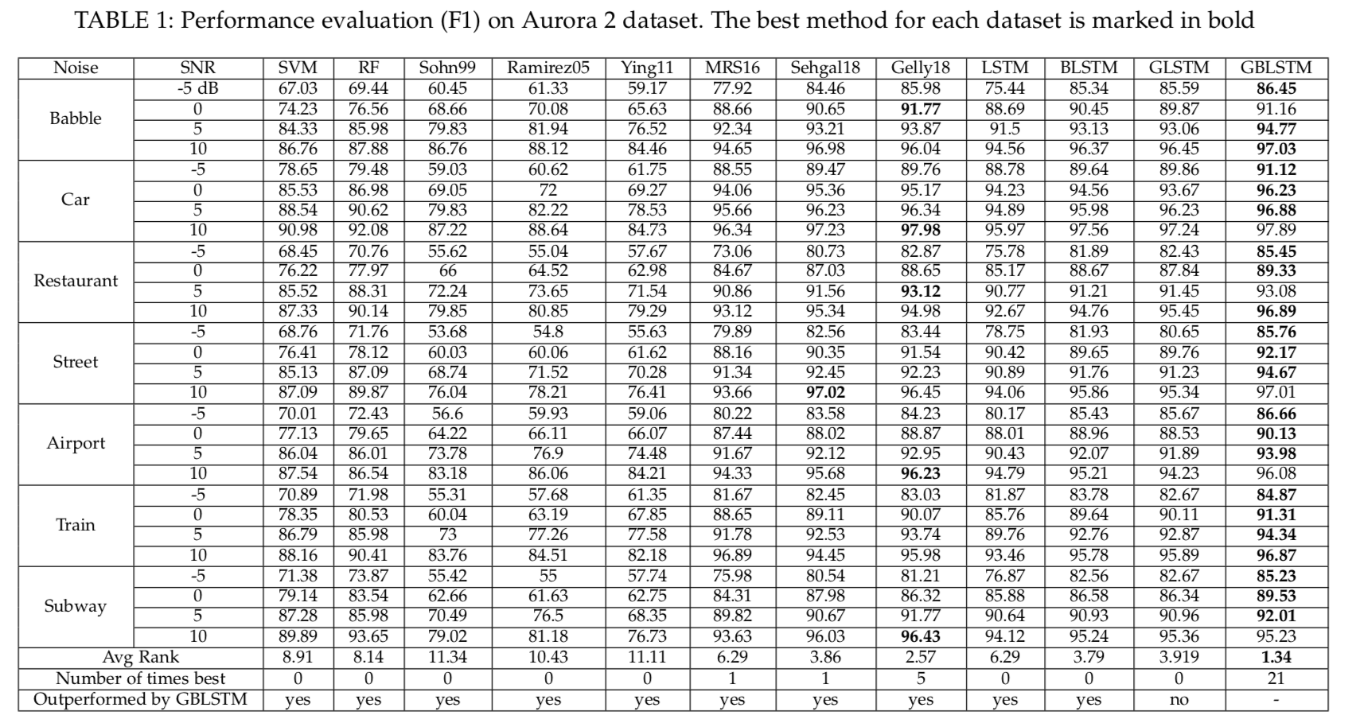
Results: Public Datasets

Slide 32
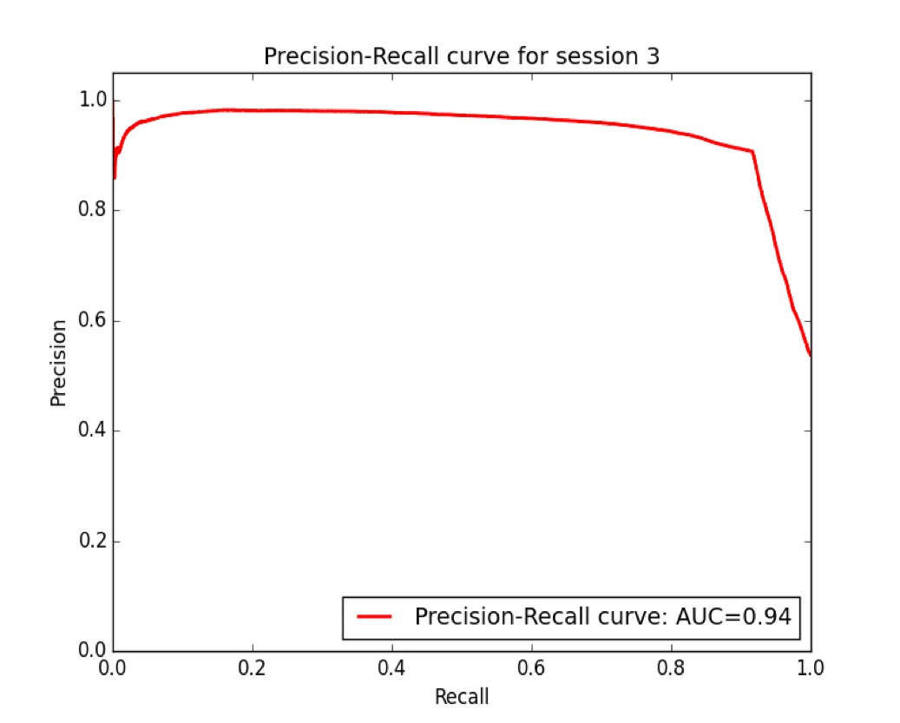
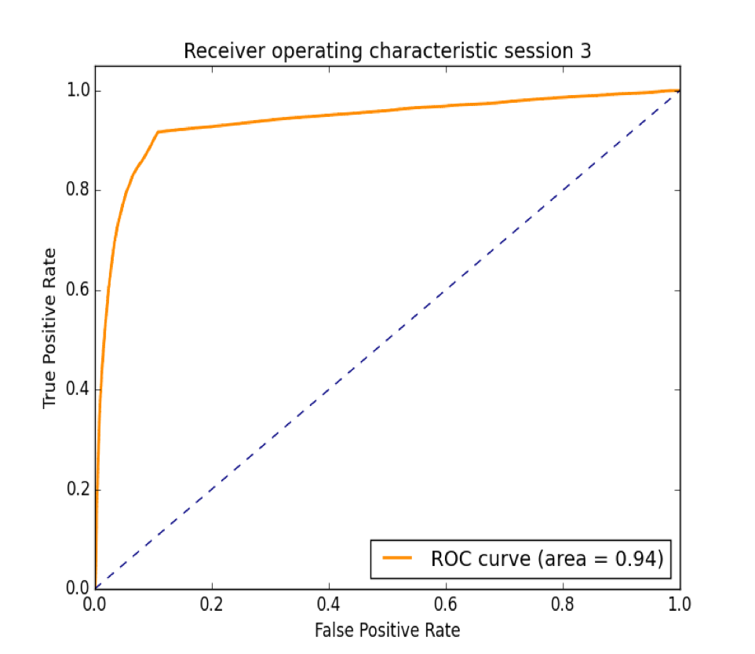
Results: Discussions Dataset

Slide 33
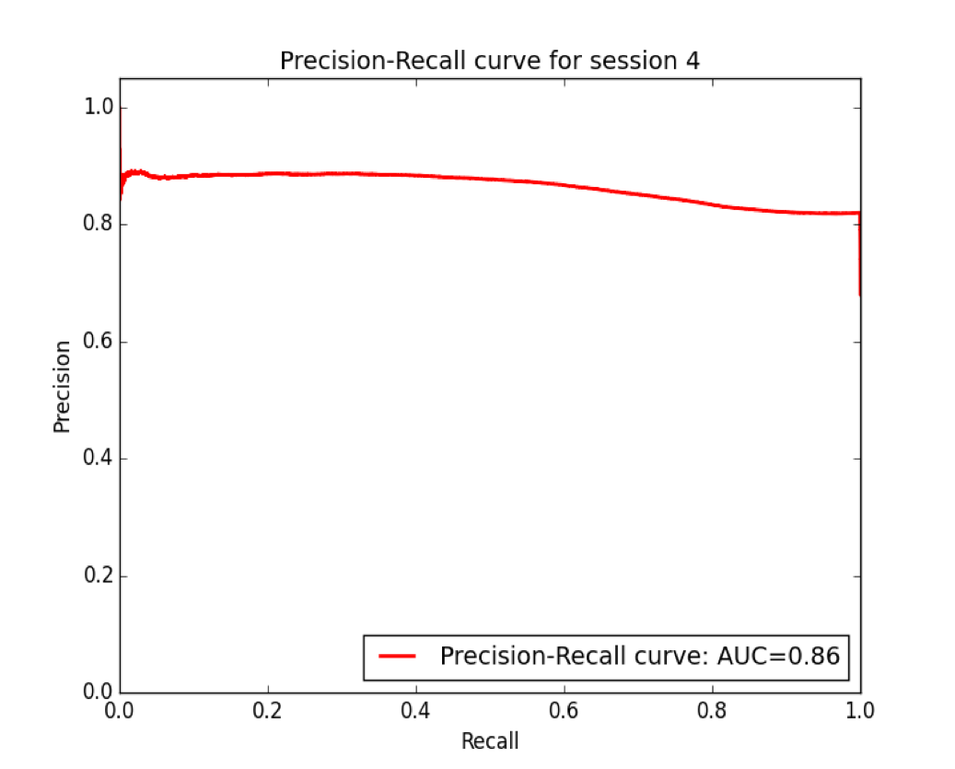
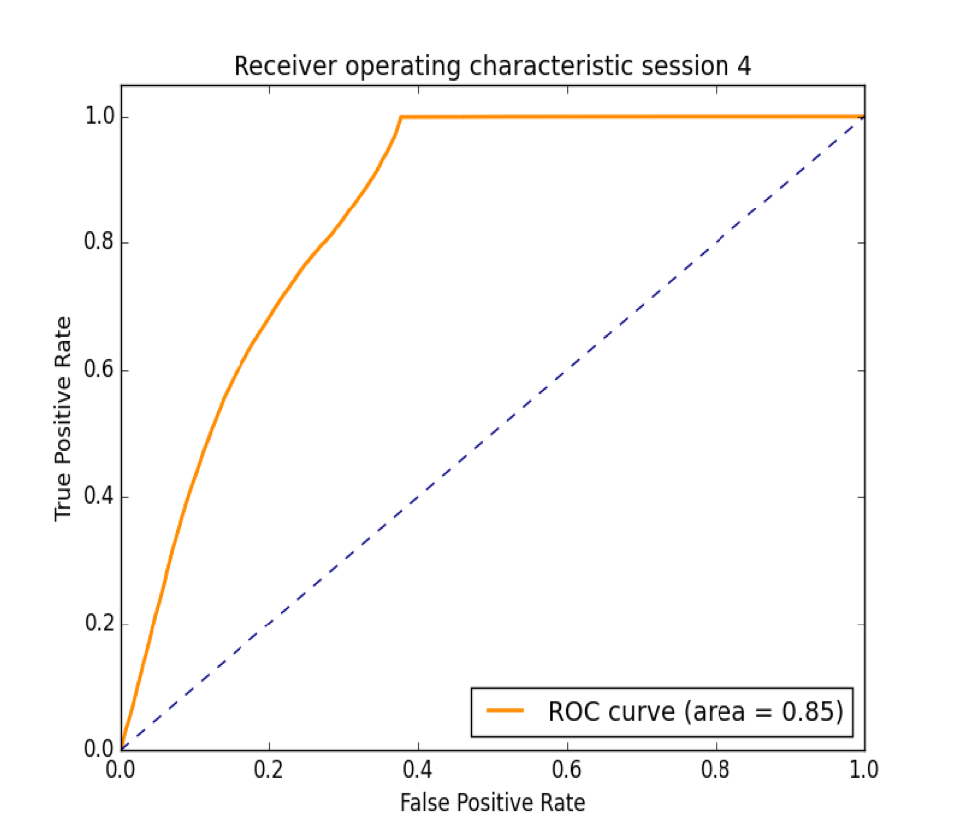
Results: Discussions Dataset

Slide 34
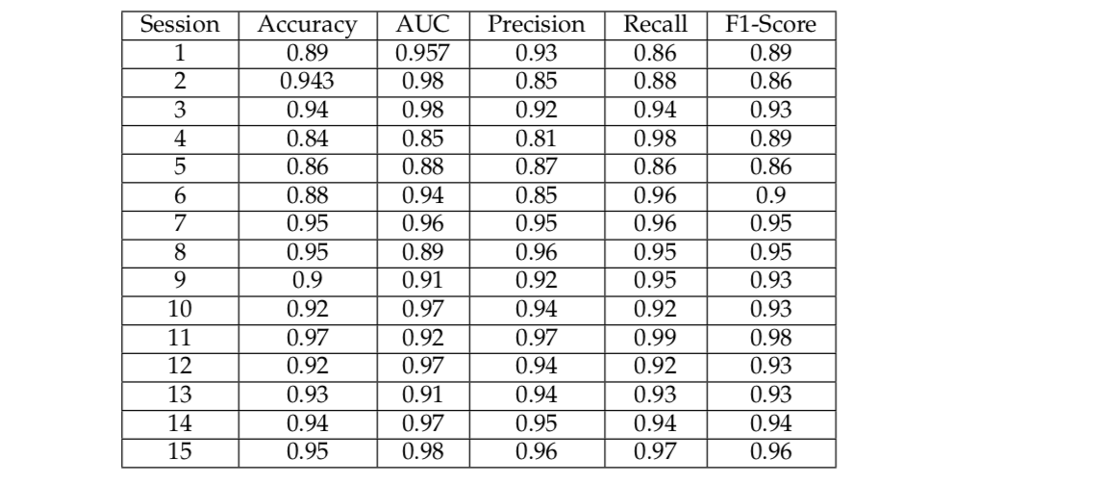
Results: Discussions Dataset

Slide 35
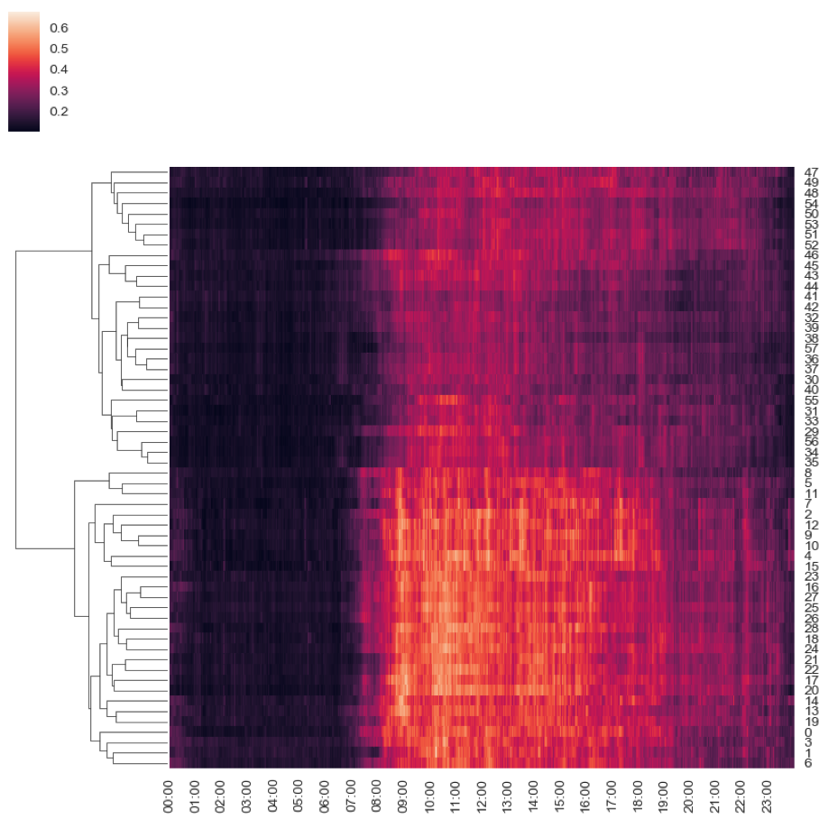
Results: Depression Dataset
Depressed Cohort
Control Subjects

